Slide 1


Project: Match-A-Pet
Team: Deus Ex-Machina (God of Tech)
Benjamin Teo (bt839)
Gururaj Shinde (gss399)
Peter Geras (psg2)
Shruti Agarwal (sa5659l)
Sean Hornbuckle (sh4986)

Slide 2
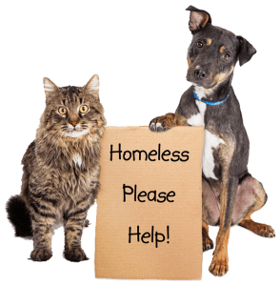
Our Mission
The motivation behind our project is to increase the reach of animal shelters to the general public; thus, encouraging adoptions over buying animals from Pet Shops and breeders.
The plan is to have potential adopters connect emotionally with animal by regular exposure.
Notes:
The regular exposure would work just how you get attached celebrities by seeing them on a daily basis.
So the driving factor was wanting to save animal lives by encouraging adoption of healthy adoptable animals who are euthanized simply because the shelter doesn’t have enough space. And
Encouraging adoption over buying pets from breeders.
All this so that at the end of the day we have
Happier animals and happier people! :)

Slide 3

The Project
A centralized portal that provides information on animals available for adoption in all shelters in a particular region, while prioritizing adoption of senior animals, those whose euthanization dates are near and those who have been in the shelter for too long.
Platform is to be accompanied by a portal for the Shelter staff and volunteers with a highly simple UI that will make it easy for them to update animal profile and make regular posts.
*
‹#›
Notes:
A centralized portal that provides information on animals available for adoption in all shelters in a particular region, while prioritizing adoption of senior animals, those whose euthanization dates are near and those who have been in the shelter for too long.
Platform is to be accompanied by a portal for the Shelter staff and volunteers with a highly simple UI that will make it easy for them to update animal profile and make regular posts.

Slide 4
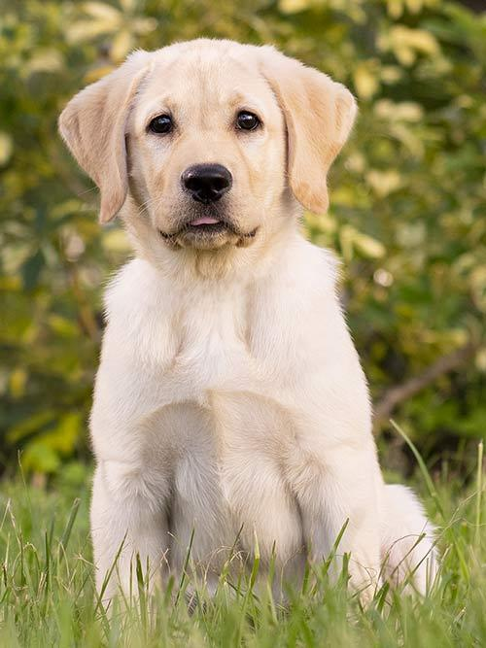
Why is this different?
Websites for adoptions, at present, do exist, however, people are motivated to visit them only once they have made up their mind to adopt a pet. Our site would provide more than just adoption services.
We combine the traffic of a social media website with the services of an adoption website.
‹#›
Notes:
If you look at social media trends then posts under animal hashtags have a huge following and garner a huge number of likes. Our site would provide more than just adoption services. It would basically try to cater to even that audience which is not immediately interested in adopting a pet. This can be done by designing our website on a social media template, where users can follow certain dog breeds and shelters (coupled under various hashtags) and receive updates on them just as you would get on Instagram or FB.. There’s a huge scope for expansion in this, the basic idea being that we sneak in the the pet-adoption part subconsciously in to a person’s regular internet activity. Regular adoption websites do not have traffic on them, social media websites have traffic on them. We here are going to combine the two

Slide 5
Major Features
Centralized portal for all animal shelters.
Website will be based on a Social media template.
Users can follow certain breeds, shelters, animal profiles via hashtags.
An area that allows shelter volunteers and staff to to upload pictures, stories, advice, etc of the animals, and later even for people who have adopted (Adoption success stories)
Engaging and highly user friendly interface, especially for the shelter staff segment.
Start locally such as Brooklyn and NYC and then gradually expand area.
Users can swipe on pet profiles to indicate their preferences (think Tinder) and the ML algorithm will pick up that pattern and provide suggestions accordingly.
‹#›
Notes:
1. Not necessary that each shelter has a very efficient website that’s routinely updated.
That will help us have increased traffic. ALso, adoption websites are visited people who have made up their mind that they are ready to adopt. What we want to do is encourage users to not just like a cute animal picture on social media but actually go ahead and adopt homeless animals
Hashtags will double as filters

Slide 6
Extended Features
Use of Google Maps API to show the user where the shelter is located
Alerts on preferred animal availability
Visualize statistics of adoptions
Another swiping feature could involve having pet-owners connect with each other to organize play-dates for their pets, and provide information on popular meetup spots
Containerize all the codebase and deploy it in the cloud and having different environments
‹#›
Notes:
A visual interface for users Which area has the highest rate of adoptions and how we can target those areas more to do promotional events
Alerts on preferred animal availability
Availability of variety of filters to select adoptable animals. e.g. Adoption Deposit, medical-conditions.
Integrate algorithm to match people (based on their lifestyle) to animals in accordance with their temperament and physical needs.
Extended services like enabling pet-owners to connect with each other and organize play-dates for their pets, and provide information on popular meetup spots
Visualize statistics of adoptions.
Start locally such as Brooklyn and NYC and then gradually expand area.

Slide 7
Risks and Challenges
Database storage and processing
Keeping the user engaged - a slow site would lose users
Shelter staff participation
*
‹#›
Notes:
Database storage and processing could become a problem given the huge amount of media content. Also, initial data will be pulled from existing websites by creating custom APIs. We would need to do this until we have enough participation form the shelters.
It is required that the site be developed such that it loads quickly. A slow site will easily lose users. Doing this for the media content could be difficult but we could take hints from Instagram’s algorithm for doing so, where it downloads part of the content in the background while you are viewing something else.
Convincing shelter staff to use the website, trust the platform and actively post about the animals would require effort.
The project is a social experiment that may or may not appeal to the users. Our best efforts will be to make it a success based on feedback.

Slide 8
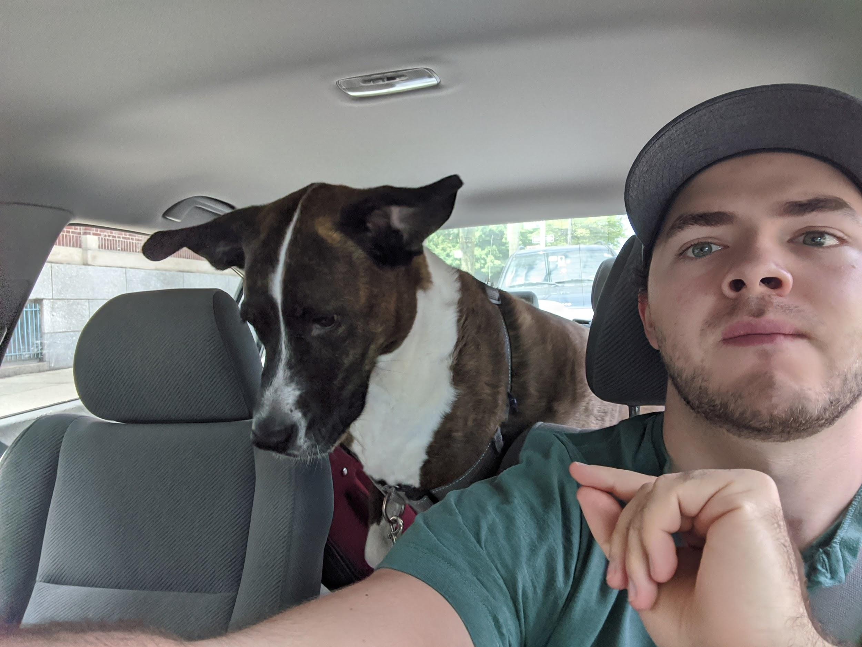
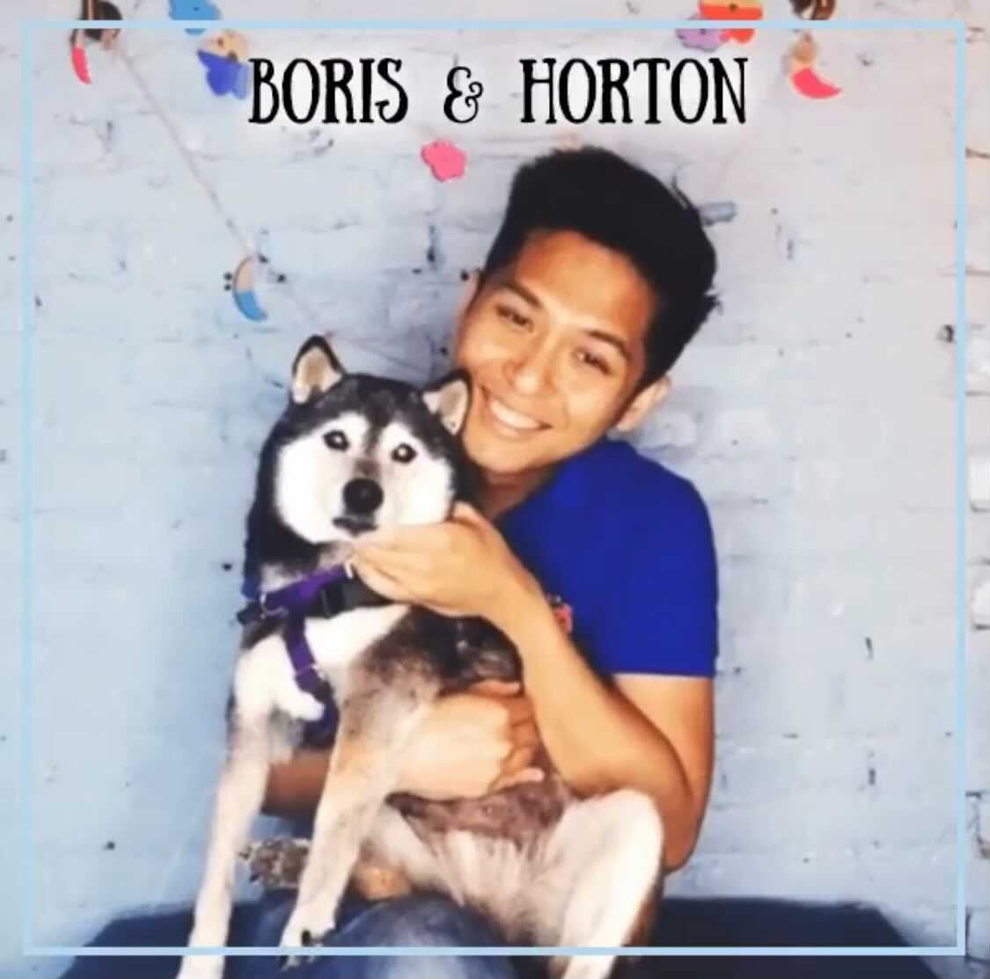
Connecting loving pets to families

